Slide 1
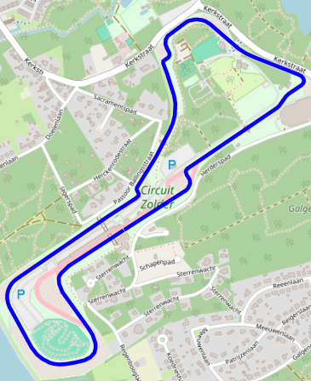
A Strategy model for iLumen solar car challenge

Slide 2
Problem Statement
1. How can we ensure the battery maintains sufficient charge to complete each race lap?
2. Given our constraints of car specification, weather conditions, and route topography, how can we develop a strategy to maximize the number of laps completed within a 24-hour race?
3. How can we design a pit stop schedule that balances energy recharging, driver swaps, and maintenance while minimizing downtime to maximize race performance?
(3 charging stops of minimum 30 minutes)

Slide 3
Functional requirements
1. The system will prevent the battery from shutting off during a race lap.
2. The system will provide a velocity profile per lap given pre defined and real time data.
3. The Telemetry system will transmit the features: distance, speed, power, current, Ah, flgs, AuxD, AuxA, Thi, Tho, RPM, degree, longitude, latitude and Time (15 features).
4. The system will save the real-time telemetry data into a DB, and will be shown to pit crew on a real time dashboard.
5. The system will calculate the number of laps to next pit stop.

Slide 4
Non- Functional requirements
1. Performance -The telemetry system will transmit 15 features data from a raspberry pi, every second within a latency of less then a second, at least 90% of the time, by range of no more than 5km.
2. The system will transmit from the data logger sensors into the raspberry pi 4 every second, 99% of the times, handling non transmitted signals.
2. The algorithm will calculate the next lap velocity profile within no more than 5 seconds at least 99% of the time, handling failures.
3. Reliability – The system will be able to keep working all 24h race condition.
4. The predicted solar energy 24h distribution input will be in accuracy of +-20%.

Slide 5
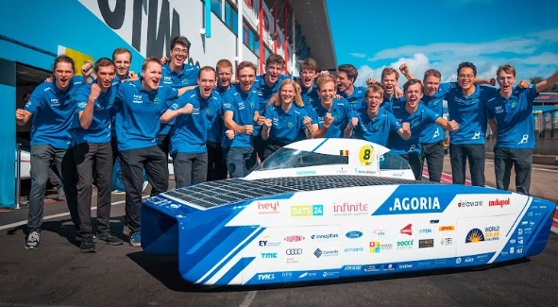
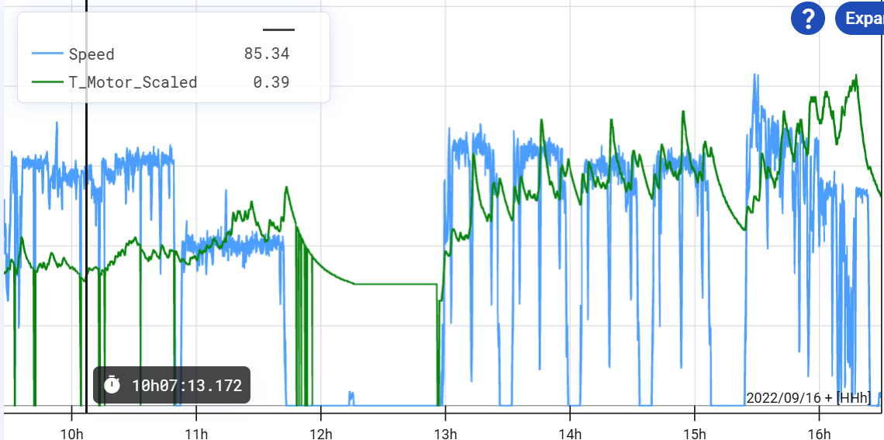
Competitors Review
Innoptus solar car team (currently the world leading team):
“Our car does a lot of data logging. In particular, the data we collect is crucial to our battery management strategy, which is key to our success in these races. We need to ensure that our battery lasts the entire race and is not depleted too early on, while also driving the race in the most efficient way possible.”
“The strategic aspect of a solar race, is mainly battery management. First, how can we drive a race, so that the battery rests the entire race, and isn't empty after day 1? Second, how can we do this in the most efficient way, aka how can we drive the race in the least amount of time and arrive at the finish line with not too much energy left?”

Slide 6
Other solar car strategy team’s GitHub repository:
1. Waterloo university strategy model:
https://github.com/uw-midsun/strategy_msxvi
2. University of Nottingham’s strategy model for Bridgestone (Australia) race:
https://github.com/henrysg1/solar-race-strategy

Slide 7
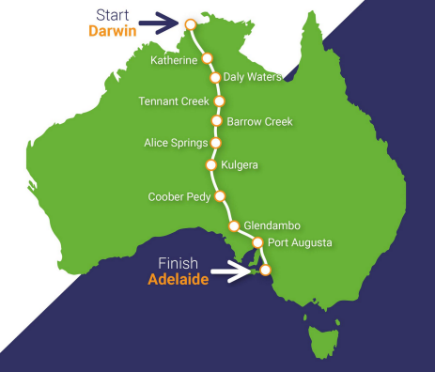
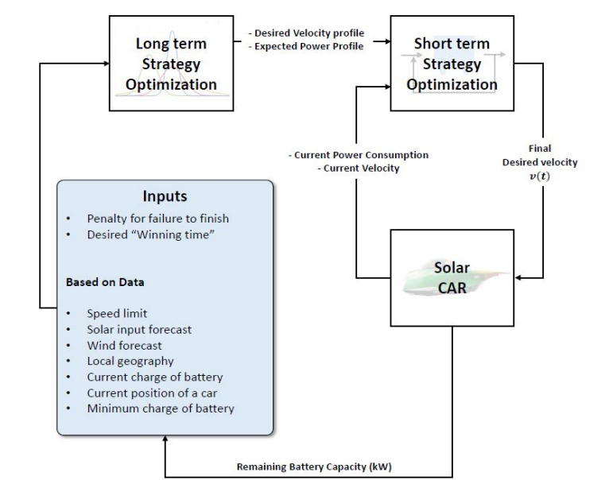
Literature Review
A novel strategy model approach for the Bridgestone World Solar Challenge
1. This project considers the derivation of strategies for a solar car race through Australia, posed by TopDutch Solar Racing. The task is to optimize the arrival time of an electric car powered by solar energy by changing the velocity along the track taking into account the characteristics of the car, external influences such as wind and sun, as well as constraints like the maximal and minimal battery charge.
2. They leverage a Model Predictive Control (MPC) method and take the approach with a long-term planner (based on past data) and short-term ones (based on dynamic programming).
Conclusion: the results of the different strategies suggest that small but significant improvements can be made using velocity optimization. Especially, the long-term strategies give realistic results and are powerful tools to increase the winning chance for the team.

Slide 8
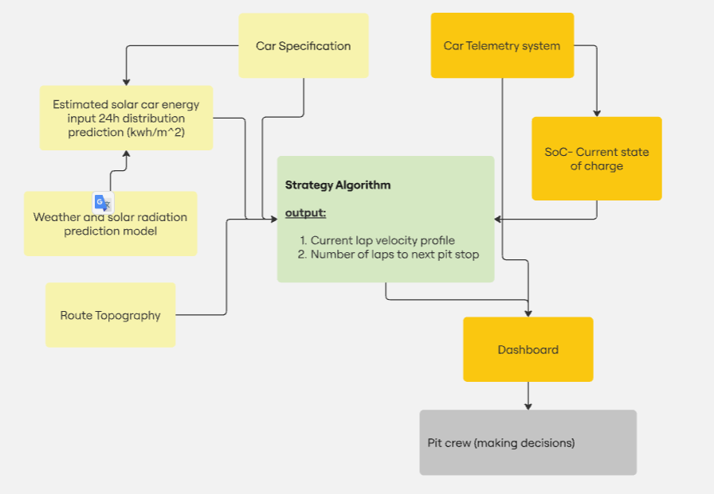
System Architecture
Yellow(left side) – pre-defined data
Orange(right side) – short term data

Slide 9
Development Stages
1. Gathering requirements from other team members such as electrical and aerodynamics teams.
2. Planning the system architecture.
3. System development:
3.1. Gathering and analyse of the circuit-zolder route (3000 lat, long, elevation points).
3.2 Gathering 10 features of weather and solar radiation from the race’s location 14 days +- from the estimated racing date (20 September), 2014-2024.
3.3 Building a 24h distribution solar energy LSTM prediction for the race.
3.4 Calculating a 24h distribution solar energy estimated input (after efficiency and panels size).
3.5 Connecting the data logger sensors into our raspberry pi 4 and visualizing them on a simple python GUI software.
3.6. Documenting relevant car specification by the other team's members.
3.7 Building the velocity profile algorithm that will be based on short term data and predefined-data.
3.8. Designing the dashboard app (probably using grafana software).
4. System testing

Slide 10
